Slide 1
CondoR
Generation of Miracles – Makati
Abaya, Manuel | Cerbo, Cheneil
Comia, Monica | Villanueva, Jose Lorenzo

Slide 2
What is CondoR?
The CondoR (short for Condominium Registration) application is a condominium visitor management system that automates the process of visitor logging in and out of a condominium.
It is developed to manage data and minimize the time taken for visitor logging, upon entering and leaving the condominium.
The system replaces the manual on-paper system of logging in and out of a condominium.
It relies on a desktop client to operate.

Slide 3
Using CondoR

Slide 4
WELCOME WINDOW
The system will greet you with the WELCOME window
Clicking the ACCOUNT LOG IN button will lead you to the Log-in window
Clicking the EXIT button will issue a prompt to exit the application

Slide 5
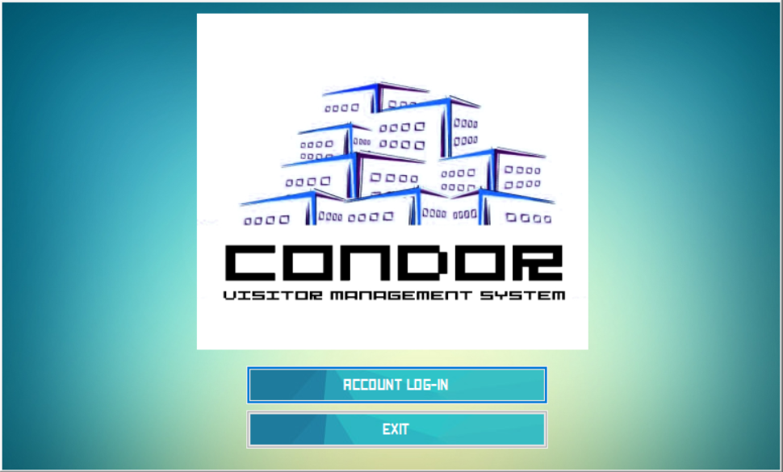

Slide 6
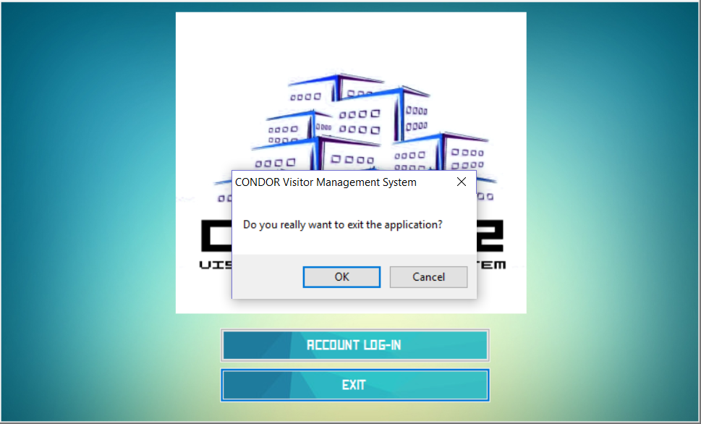

Slide 7
USER LOGIN WINDOW
The application requires user credentials registered in the database to fully access the system
Entering an invalid username and/or password will trigger a prompt that will inform the user that his/her credentials are invalid.
Entering correct credentials will access the system depending on which type of user account was entered

Slide 8
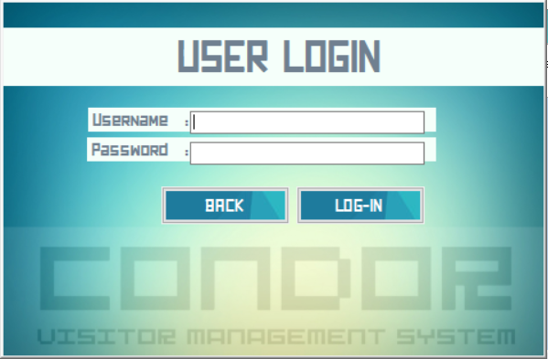

Slide 9
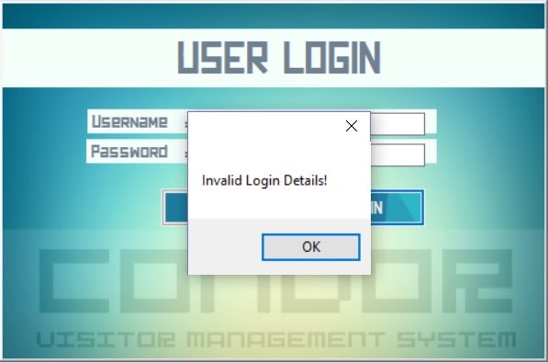

Slide 10
USERS
There are 2 types of users for this application:
Administrator
Facilitator

Slide 11
FACILITATOR MANAGEMENT
Upon log in with the administrator credentials, the application will show a Administrator-exclusive window where you have different ways to manage the Facilitators currently recognized by the system

Slide 12
FACILITATOR ACCOUNT LIST WINDOW
Provides a list of all the facilitator accounts, user names and passwords currently registered in the system
Has the buttons for creating, updating and deleting Facilitator accounts

Slide 13
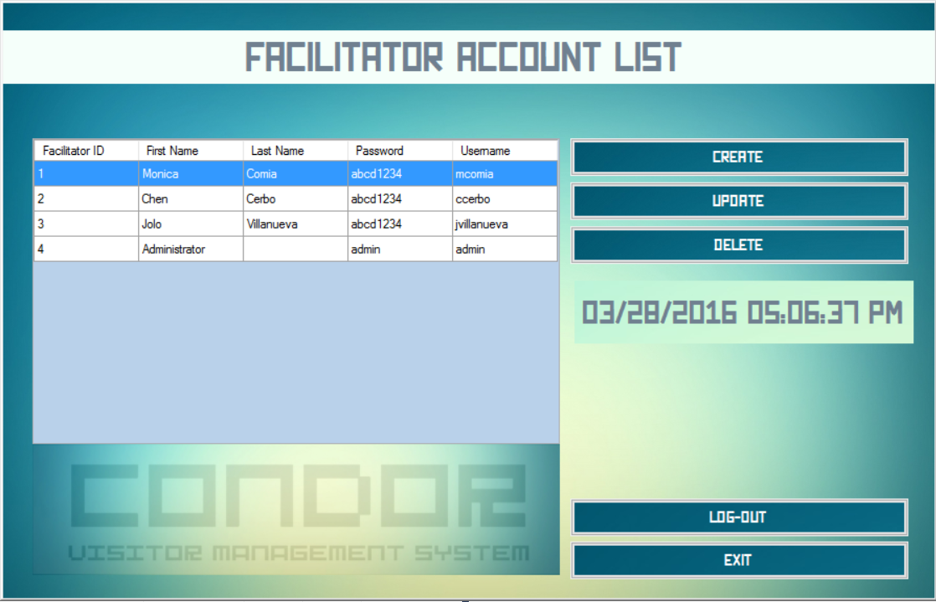

Slide 14
FACILITATOR ACCOUNT LIST WINDOW
The CREATE button leads to...
Facilitator Create Window - A window with form fields to create a Facilitator account that will be registered into the system

Slide 15
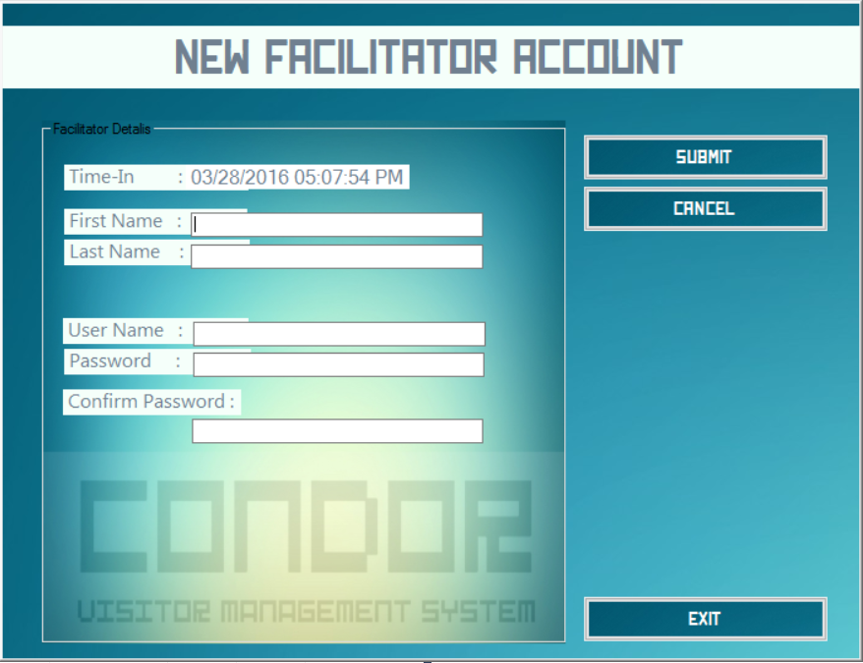

Slide 16
NEW FACILITATOR ACCOUNT WINDOW
Clicking the SUBMIT button will verify the fields (if there are any empty fields) and create the Facilitator account
The CANCEL button will return you to the facilitator list without submitting the form
The EXIT button will issue a prompt to exit the application

Slide 17
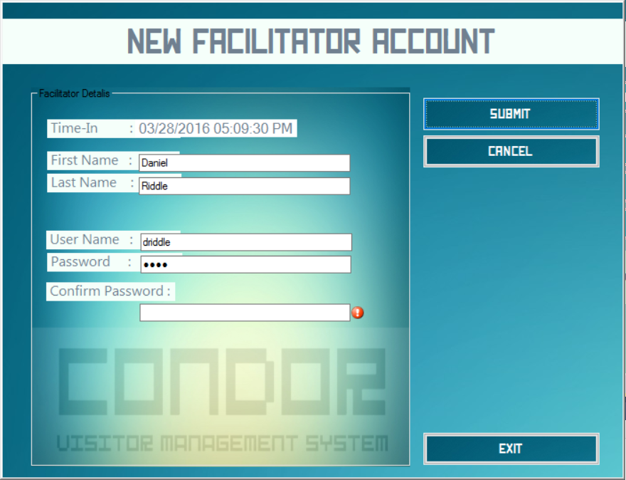

Slide 18
FACILITATOR ACCOUNT LIST WINDOW
The UPDATE button leads to...
Facilitator Update Window - A window with populated form fields (based on the selected account from the list) to update a Facilitator account currently registered in the system

Slide 19
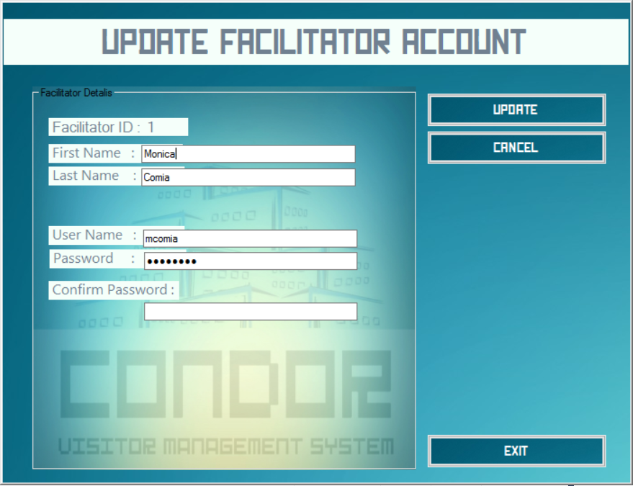

Slide 20
UPDATE FACILITATOR ACCOUNT WINDOW
The UPDATE button will verify the form fields and update the corresponding Facilitator record
The CANCEL Button will return you to the facilitator list without any changes to the record
The EXIT button will issue a prompt to exit the application

Slide 22
FACILITATOR ACCOUNT LIST WINDOW
The DELETE button will issue a prompt asking for verification to delete the record from the system database. If 'Yes' is clicked, the selected record will be deleted, otherwise, if 'No' is clicked, no action will be taken
The LOG-OUT button will issue a prompt to log-out of the system. Clicking 'Yes' will put you back at the Log-in window, 'No' cancels the prompt and takes no action.

Slide 23
VISITOR MANAGEMENT
Upon log-in with facilitator credentials, the application will lead to the visitor list window, which displays the list of all visitors and their details

Slide 24
VISITOR REGISTRATION LIST WINDOW
A SEARCH BAR is located near the top of the window. It can be used to search any specific visitor record needed by the user.

Slide 25
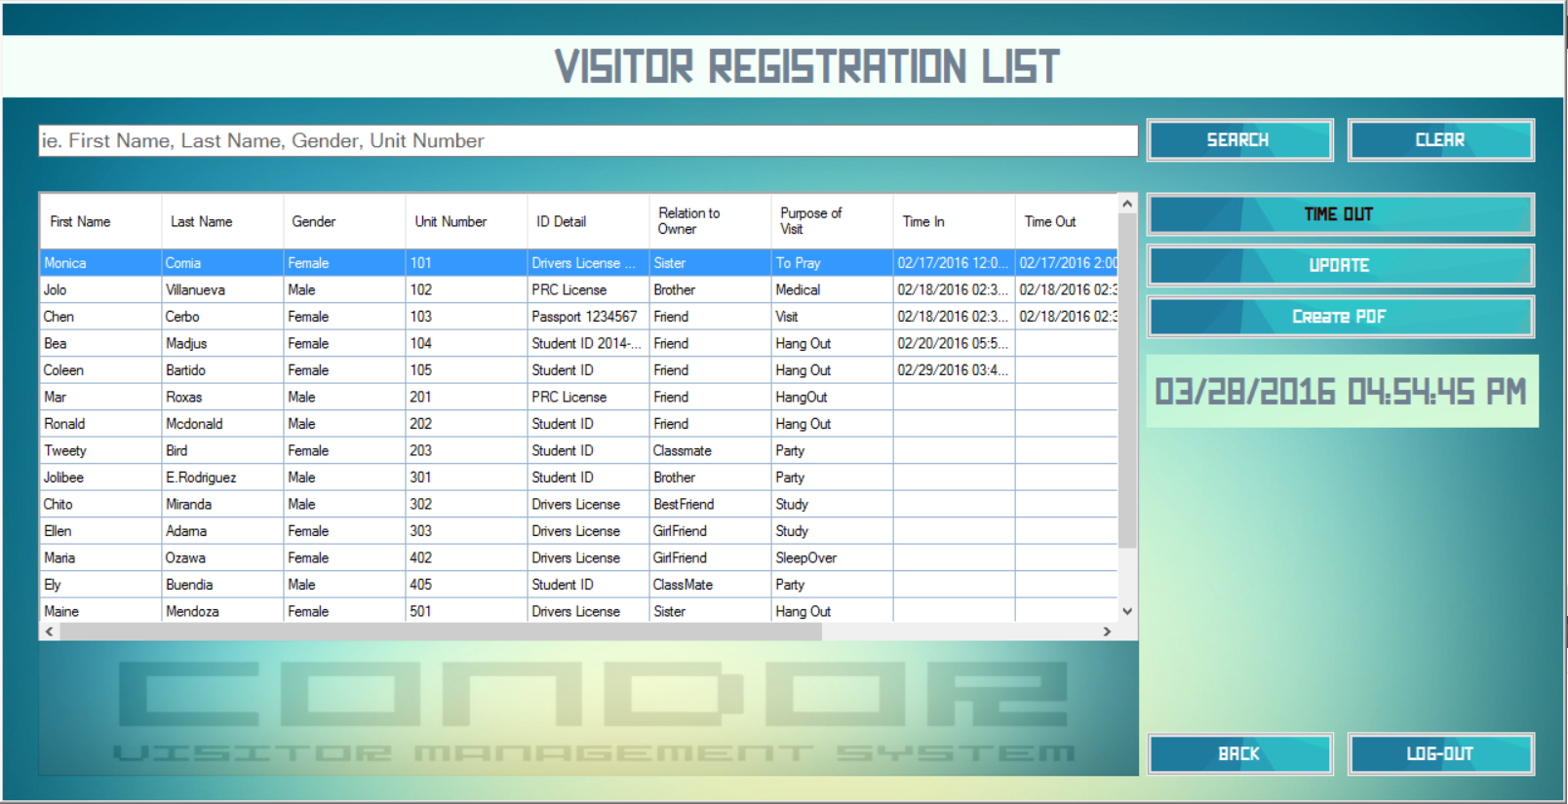

Slide 26
VISITOR REGISTRATION LIST WINDOW
The UPDATE button leads to...
Visitor Update Window - A window with populated form fields (based on the selected account from the list) to update a visitor account currently logged in the system

Slide 27
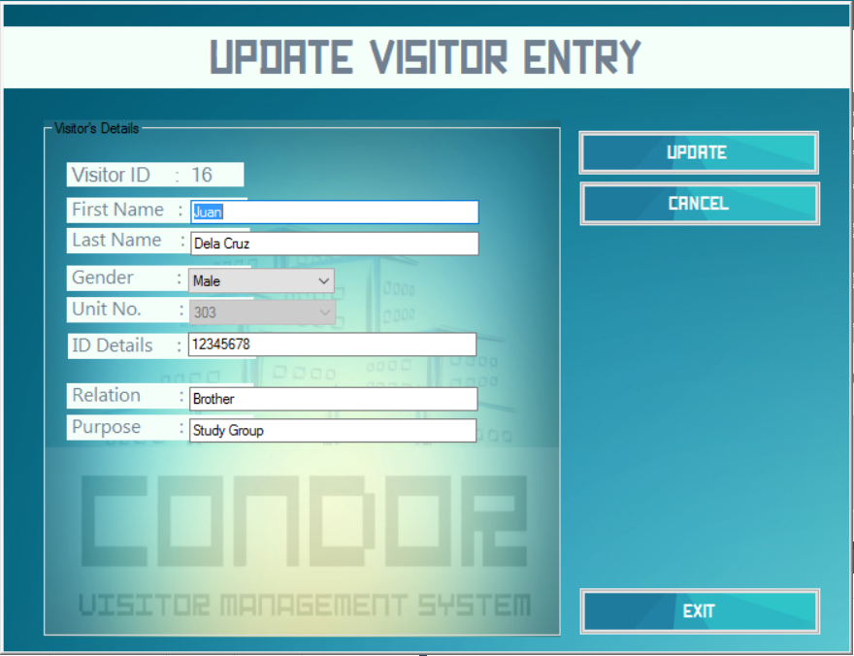

Slide 28
UPDATE VISITOR ENTRY WINDOW
The UPDATE button will verify the form fields and update the corresponding Visitor record
The CANCEL Button will return you to the visitor list without any changes to the record
The EXIT button will issue a prompt to exit the application

Slide 29
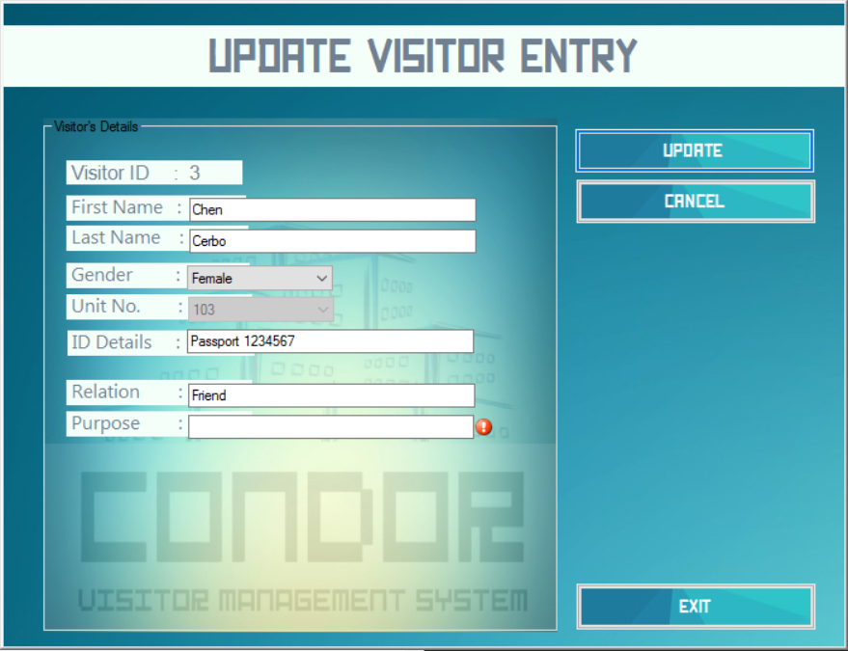

Slide 30
GENERATE PDF REPORT WINDOW
The CREATE PDF button leads to...
A window with options to generate a list of visitors within a given timeframe. The system can generate pdf files of daily, weekly and monthly reports

Slide 31
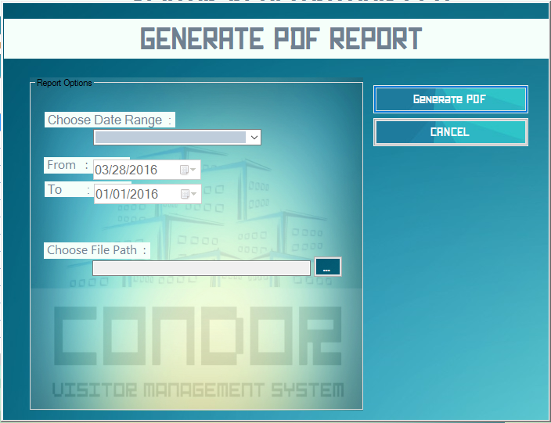

Slide 32
GENERATE PDF REPORT WINDOW
Clicking the GENERATE PDF button will check the form fields in the window and a dialog box will appear, asking the user the file name and file path. CondoR will then generate and open the report to be viewed by the user.
Clicking the BACK button will return the user to the visitor list window.

Slide 34
VISITOR REGISTRATION LIST WINDOW
The TIME OUT button takes the currently selected record and updates with the current time in the time-out column of the database.
The LOG OUT button will close the visitor list window and log the user out of the system. It will return the user to the Log in window.

Slide 35
THANK YOU ☺

